Slide 1
COMPUTER NETWORKS

Slide 2
Overview
This course introduces:
Fundamental networking concepts, terminologies, and technologies used in data communication and computer networking.
Course materials will be taught through class lecturers, individual textbook readings, discussions, assignments, and Practical labs
Continuous Assessment Test will contribute to 50% ( written CAT, Practical CAT, Assignments and presentations)
Final written Exam will contribute to 50% of your results

Slide 3
Course Content
Data Communications
Data Link Layer
Network Layer
Transport Layer
Application Layer
LAB:
Configuration of Static Routing
Configuration of Dynamic Routing: RIP
Configuration of Dynamic Routing: EIGRP
Configuration of Dynamic Routing: OSPF
Switching: Clearing interconnected switches, VLANS, VTP….

Slide 4
DATA COMMUNICATION
Telecommunication refers communication at a distance.
The term data refers to information presented in whatever form is agreed upon by the parties creating and using the data.
Data comes in different forms; text, numbers, images, audio, and Video
Data communications are the exchange of data between two devices via some form of transmission medium such as a wire cable.

Slide 5
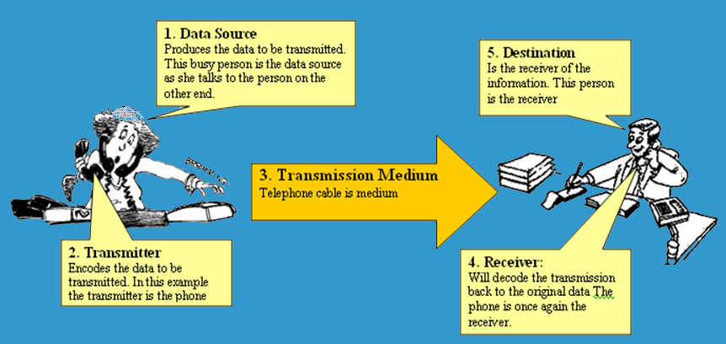
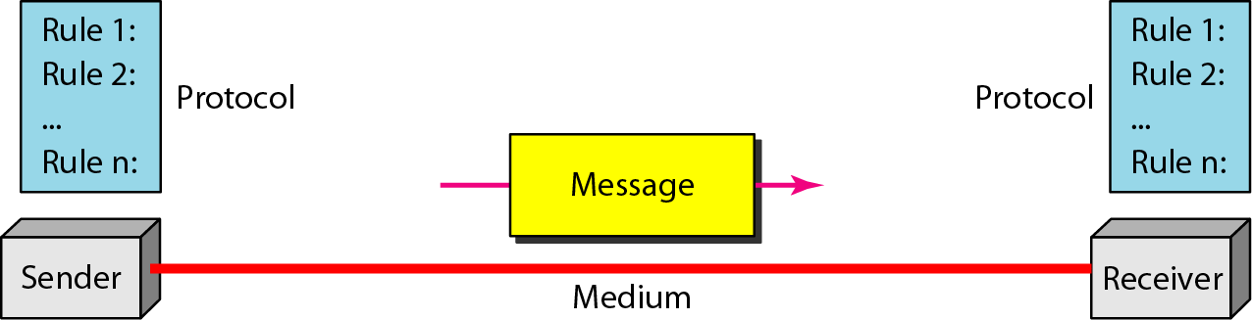
Components of Data Communication
Source/Destination (Protocol)
Transmitter (Sender)
Transmission Medium (Medium)
Receiver (Receiver)
Data (Message)

Slide 6
Direction of Data Flow
There are three directions of data flow;
Simplex
Half Duplex
Full Duplex

Slide 7
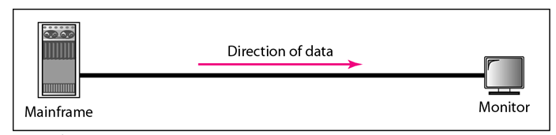
Simplex
In simplex mode, the communication is unidirectional, as on a one-way street. Only one of the two devices on a link can transmit; the other can only receive
Examples: Keyboards, traditional monitors

Slide 8
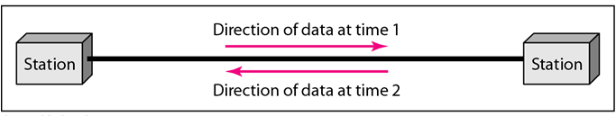
Half Duplex
In half-duplex mode, each station can both transmit and receive, but not at the same time.
When one device is sending, the other can only receive, and vice versa.
Example: a walkie-talkie

Slide 9
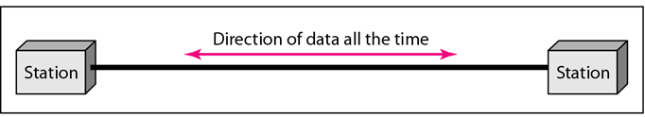
Full Duplex
In full-duplex mode(also called duplex), both stations can transmit and receive simultaneously.
Example: landline

Slide 10
Networks
A network can be defined as a set of devices (Nodes) connected by communication links.
A node can be a computer, printer, or any other device capable of sending and/or receiving data generated by other nodes on the network.
A link can be a cable, air, optical fiber, or any medium which can transport a signal carrying information.

Slide 11
Components and Categories of a Network
A network is composed of different things like;
end nodes (device + interface)
Links
interconnection network
etc

Slide 12
Network Categories
Network Categories include;
Local Area Networks (LANs)
Wide Area Networks (WANs)
Metropolitan Area Networks (MANs)

Slide 13
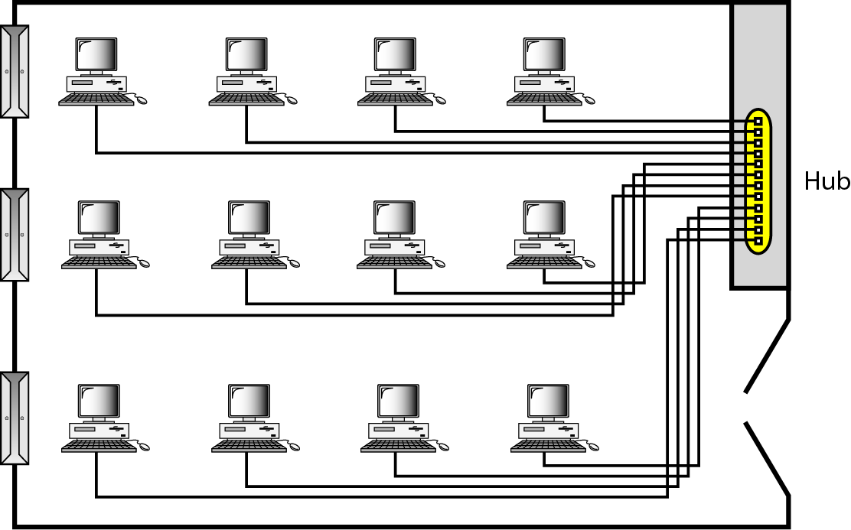
LAN
Local Area Networks (LANs): LAN is usually privately owned and links the devices in a single office, building, or campus.
  Short distances
  Designed to provide local interconnectivity

Slide 14
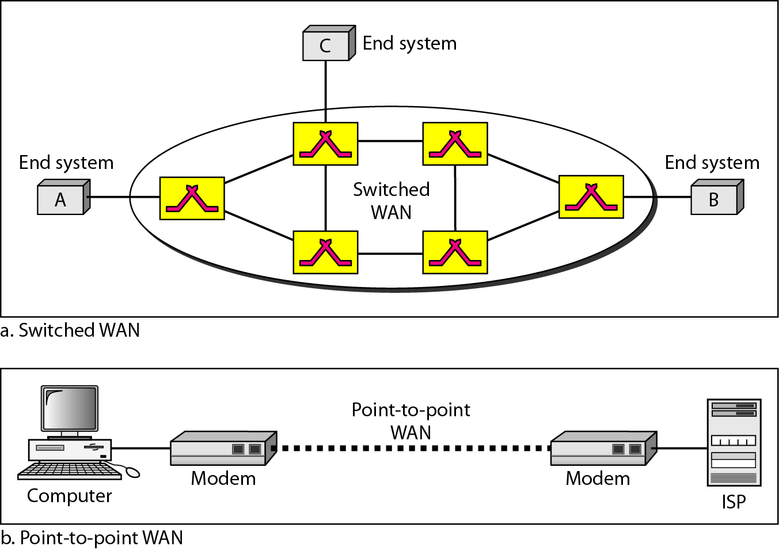
WAN
Wide Area Networks (WANs): WAN provides long-distance transmission of data, image, audio, and video information over large geographic areas that may comprise a country, a continent, or even the whole world.
  Long distances
  Provide connectivity over large areas

Slide 15
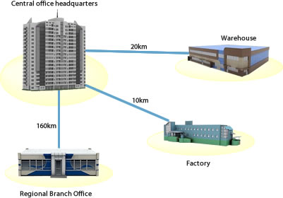
MAN
Metropolitan Area Networks (MANs): MAN is a network with a size between a LAN and a WAN.
  Provide connectivity over areas such as a city, a campus

Slide 16
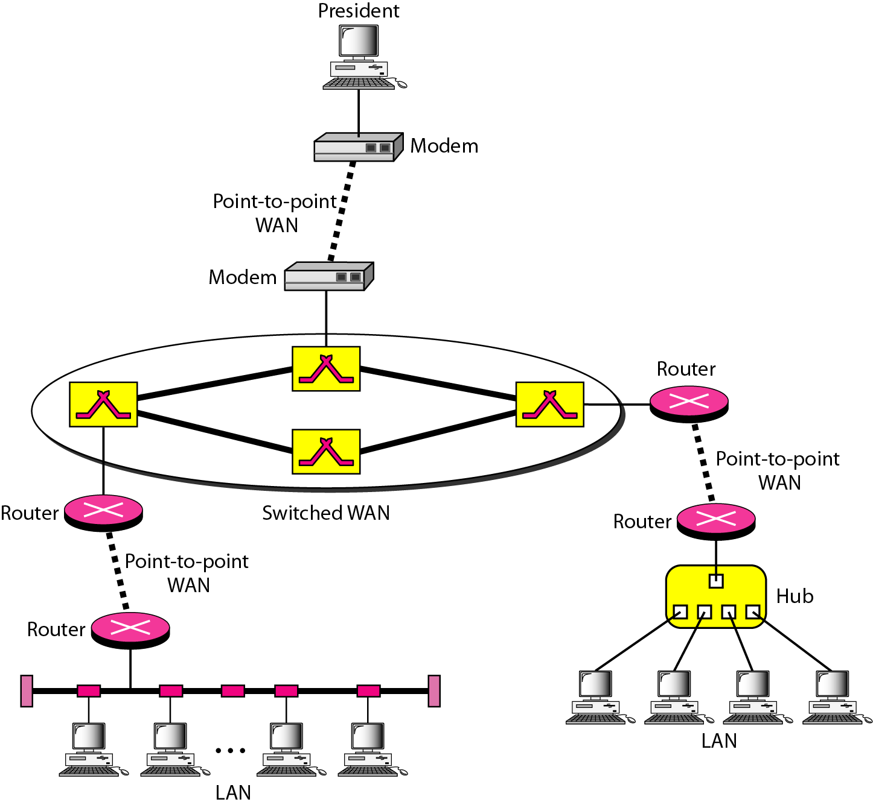
A heterogeneous network made of four WANs and two LANs

Slide 17
Network Criteria
A network must be able to meet a certain number of criteria. The most important of these are:
1. Performance:
  Depends on Network Elements
  Measured in terms of Delay and Throughput
2. Reliability:
  Failure rate of network components
  Measured in terms of availability/robustness
3. security:
  Data protection against corruption/loss of data due to:
      Errors
      Malicious users

Slide 18
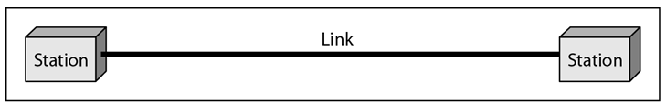
Types of Connection
  1. Point to Point: A point-to-point connection provides a dedicated link between two devices. The entire capacity of the link is reserved for transmission between those two devices. Most point-to-point connections use an actual length of wire or cable to connect the two ends.

Slide 19
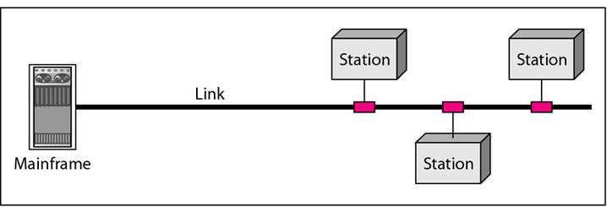
Cont’d
2. Multipoint: A multipoint (also called multidrop) connection is one in which more than two specific devices share a single link.
In a multipoint environment, the capacity of the channel is shared, either spatially or temporally/timeshared. If several devices can use the link simultaneously, it is as spatially shared connection. If users must take turns, it is a timeshared connection.

Slide 20
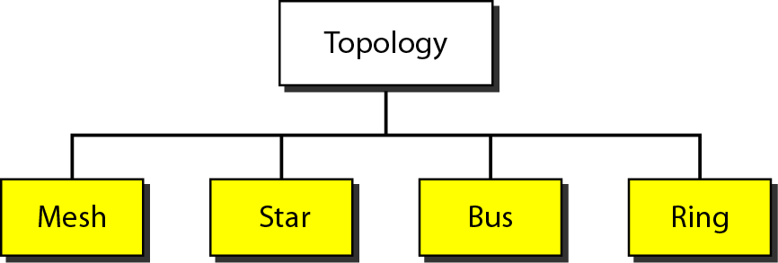
Topologies
There are different types of network topologies;
Mesh
Star
Bus
Ring
Hybrid

Slide 21
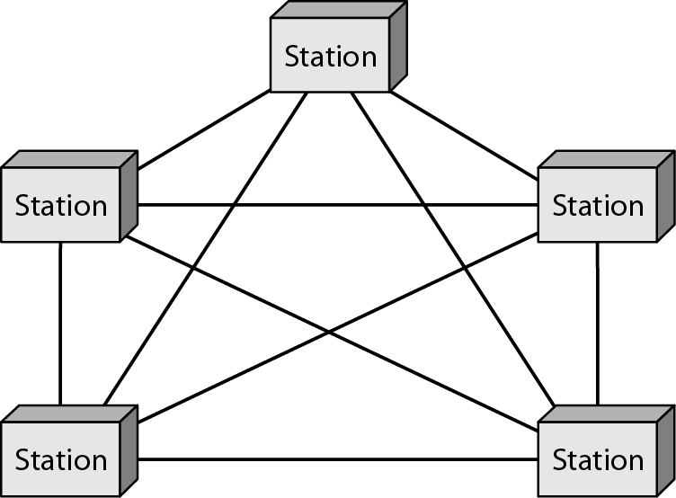
MESH
In a mesh topology, every device has a dedicated point-to-point link to every other device.
The term dedicated means that the link carries traffic only between the two devices it connects

Slide 22
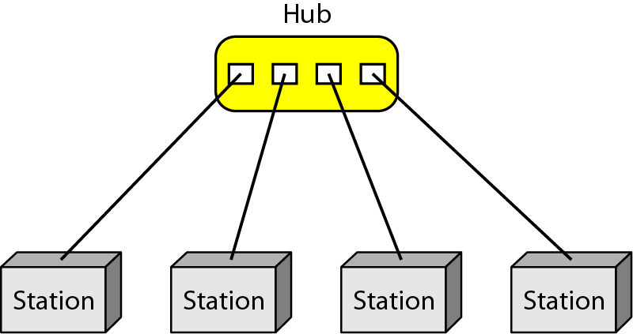
Star
In a star topology, each device has a dedicated point-to-point link only to a central controller, usually called a hub.
The devices are not directly linked to one another. Unlike a mesh topology, a star topology does not allow direct traffic between devices.
The controller acts as an exchange: If one device wants to send data to another, it sends the data to the controller, which then relays the data to the other connected device.

Slide 23
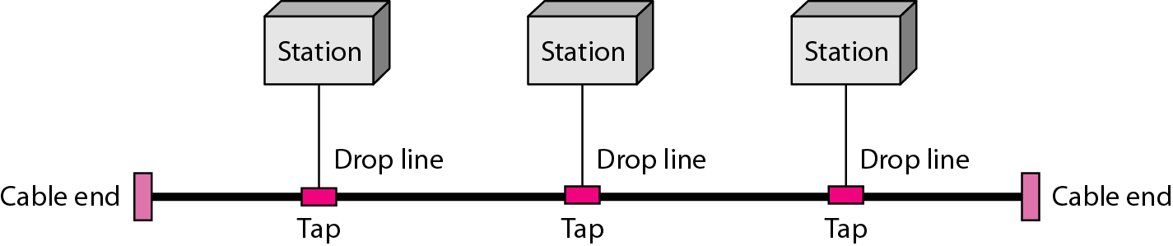
Bus
The previous examples are all point-to-point connections, a bus topology, on the other hand, is multipoint.
One long cable acts as a backbone to link all the devices in a network, nodes are connected to the bus cable by drop lines and taps.
A drop line is a connection running between the device and the main cable.
A tap is a connector that either splices into the main cable or penetrates the sheathing of a cable to create a contact with the metallic core

Slide 24

RING
In a ring topology, each device has a dedicated point-to-point connection with only the two devices on either side of it.
A signal is passed along the ring in one direction, from device to device, until it reaches its destination.
Each device in the ring incorporates a repeater. When a device receives a signal intended for another device, its repeater regenerates the bits and passes them along.

Slide 25
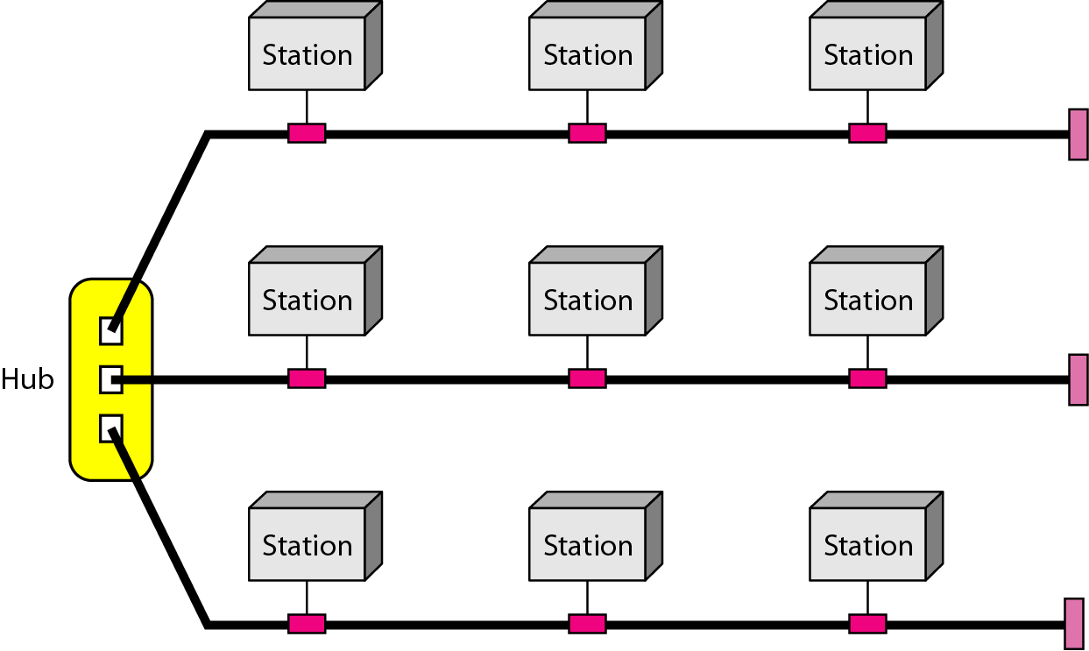
Hybrid ( a star backbone with three bus networks)
A network can be hybrid. For example, we can have a main star topology with each branch connecting several stations in a bus topology

Slide 26
Protocols and Standards
Protocols
A protocol is identical with a rule.
It consists of a set of rules that govern data communications.
It determines what is communicated, how it is communicated and when it is communicated.
The key elements of a protocol are syntax, semantics and timing

Slide 27
Elements of a Protocol
1. Syntax: The term syntax refers to the structure or format of the data, meaning the order in which they are presented. For example, a simple protocol might expect the first 8bits of data to be the address of the sender, the second 8bits to be the address Of the receiver, and the rest of the stream to be the message itself.
2. Semantics: The word semantics refers to the meaning of each section of bits.
How is a particular pattern to be interpreted, and what action is to be taken based
on that interpretation? For example, does an address identify the route to be taken
or the final destination of the message?
3. Timing: The term timing refers to two characteristics: when data should be sent
and how fast they can be sent. For example, if a sender produces data at 100 Mbps
But the receiver can process data at only 1Mbps, the transmission will overload the
receiver and some data will be lost.

Slide 28
Standards
Standards are agreed-upon rules.
Standards are essential in creating and maintaining an open and competitive market for equipment manufacturers and in guaranteeing national and international interoperability of data and telecommunications technology and processes.
Data communication standards fall into two categories: de facto (meaning "by fact" or "by convention") and de jure (meaning "by law" or "by regulation").

Slide 29
Standards Organizations
Standards are developed through the cooperation of standards creation committees, forums, and government regulatory agencies.
There are different standard creation committees;
International Organization for Standardization(ISO)
International Telecommunication Union-Telecommunication Standards Sector (ITU-T).
American National Standards Institute (ANSI).
Institute of Electrical and Electronics Engineers (IEEE).
Electronic Industries Association (EIA).

Slide 30
ISO / OSI model
Established in 1947, the International Standards Organization (ISO) is a multinational body dedicated to worldwide agreement on international standards.
An ISO standard that covers all aspects of network communications is the Open Systems Interconnection (OSI) model. It was first introduced in the late 1970s.
Note: ISO is the organization. OSI is the model

Slide 31
Layers of the OSI Model
Application
Upper layers provides the way applications with in the end stations will communicate with each other and with users
Upper Layer
Presentation
Session
Transport
Lower Layers provides
the ability for end stations
to establish connections
to each other in order
to exchange information
Network
Lower Layer
Data Link
Physical

Slide 32
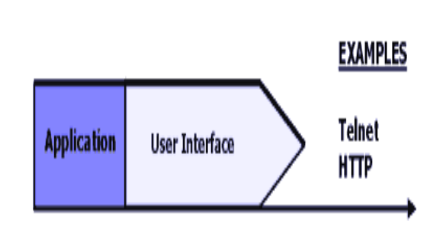
Application Layer
The application layer contains a variety of protocols that are commonly needed by users. One widely-used application protocol is HTTP (HyperText Transfer Protocol), which is the basis for the World Wide Web.

Slide 33
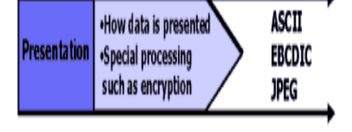
Presentation Layer
The presentation layer is concerned with the syntax and semantics of the information transmitted..

Slide 34
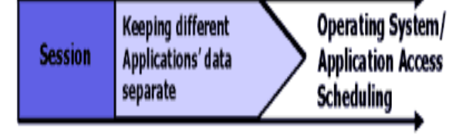
Session Layer
The session layer allows users on different machines to establish sessions between them.
Sessions offer various services, including dialog control (keeping track of whose turn it is to transmit), token management (preventing two parties from attempting the same critical operation at the same time), and synchronization (check pointing long transmissions to allow them to continue from where they were after a crash).

Slide 35
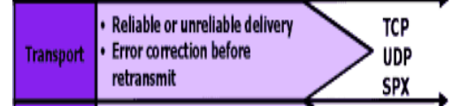
Transport Layer
The basic function of the transport layer is to accept data from above, split it up into smaller units if need be, pass these to the network layer, and ensure that the pieces all arrive correctly at the other end.

Slide 36
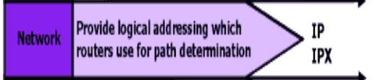
Network Layer
The network layer controls the operation of the subnet.
A key design issue is determining how packets are routed from source to destination.
Routes can be based on static tables that are ''wired into'' the network and rarely changed.

Slide 37
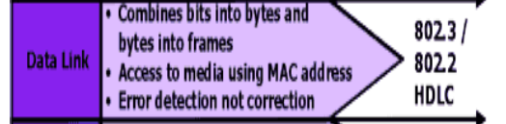
Data Link Layer
The main task of the data link layer is to transform a raw transmission facility into a line that appears free of undetected transmission errors to the network layer.
It accomplishes this task by having the sender break up the input data into data frames (typically a few hundred or a few thousand bytes) and transmit the frames sequentially.
If the service is reliable, the receiver confirms correct receipt of each frame by sending back an acknowledgement frame

Slide 38
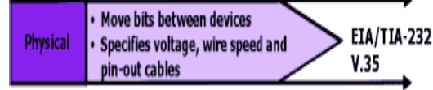
Physical Layer
The physical layer is concerned with transmitting raw bits over a communication channel.
The design issues have to do with making sure that when one side sends a 1 bit, it is received by the other side as a 1 bit, not as a 0 bit.

Slide 39
Practical Lab
Labs will be simulated using Packet Tracer
Getting Familiar with the simulator
Static Routing Configurations (Lab 1)

